Slide 1
GitLab Overview
TekSystems Lunch & Learn
Dominic Tippabattuni

Slide 2
About me…
Software Developer
Work Interests
CloudNative Applications
DevOps
Secure Coding
3rd Presentation @ Tek Lunch & Learn

Slide 3
Topics covered…
Overview of GitLab features
GitLab for
Collaboration
Documentation
Planning
Source Code Management
CI/CD Pipelines

Slide 4
Topics Not Covered…
Implementation Details
GitLab for
Release Management
Configuration Management
Monitoring
Winning Presidential Elections!

Slide 5
Attendees…

Slide 6
GitLab Vision
Everyone can contribute to all digital content.

Slide 7
About GitLab
Started in 2011
Ruby on Rails application
Redis, PostgreSQL or MySQL
Supported Editions:
GitLab Community Edition (CE)
GitLab Enterprise Edition (EE)

Slide 8
About GitLab
GitLab Enterprise Edition (EE)
Starter
Premium
Ultimate
https://about.gitlab.com/

Slide 9
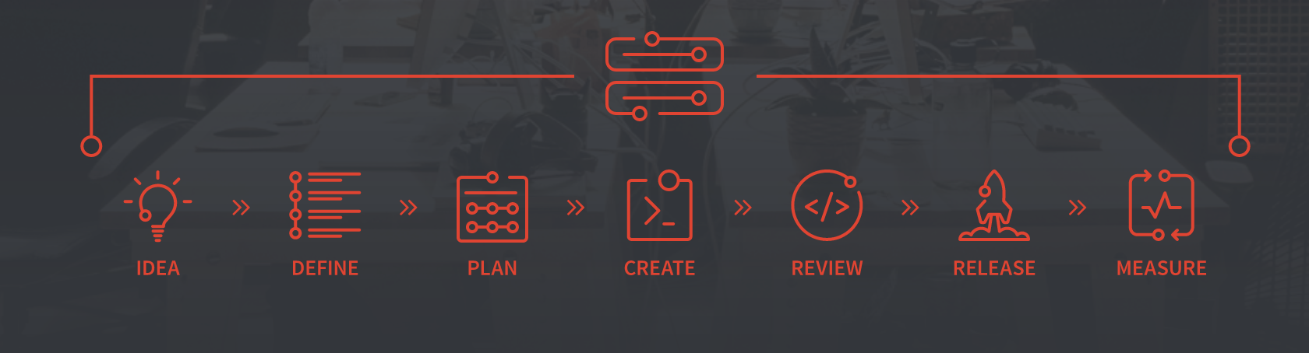
GitLab Features
>70 features
https://about.gitlab.com/gitlab-com/

Slide 10
GitLab vs Other DevOps Tools…

Slide 11
GitLab Basics
User Login
Groups
Group Membership
Permissions
Projects

Slide 12
GitLab Documentation Features
Wiki
Markdown format

Slide 13
GitLab Plan Features
Issue Tracker
Milestones
Labels
Boards

Slide 14
Source Code Management
Repository
Branches & Tags
Commits History
Fork / Merge

Slide 15
GitLab – SCM Workflows
Git Command Line Interface
clone
add - stage files
commit
push
pull
Git IDE Plugin

Slide 16
SCM Workflows - Simple

Slide 17
SCM Workflows

Slide 18
SCM Workflows - Environments

Slide 19
GitLab CI/CD
Enable CI/CD
.gitlab-ci.yml file
Stages
Jobs
Scripts
Cache
Git Runners – Specific & Shared Runners

Slide 20
GitLab – Jenkins Integration
Jenkins GitLab Plugin
Jenkins Git Plugin
Jenkins Project Service

Slide 21
Overall Thoughts!
Great for SCM!
CI/CD built for container deployments
Every task is an Issue?
Feature Creep!

Slide 22
Questions?

Slide 23
Thank You !!!

